Slide 1
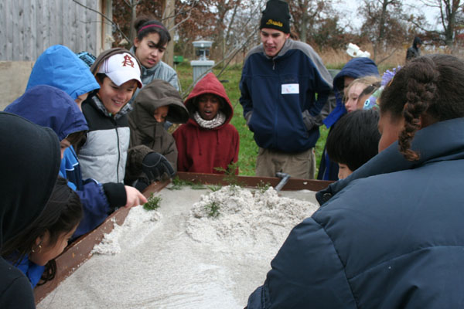
Stream Table Lesson Plan
Greg Carling and Megan Crocker
Geology Students Extraordinaire!

Slide 2
Goals for the Lesson
This lesson will focus on the water cycle, erosion and deposition, and watersheds and
aquifers. The stream table allows students to experiment with stream processes in
the classroom environment that normally can only be observed in the field.
Goals for this activity:
Students will understand various aspects of river processes and forms, including erosion, sediment transport and sediment deposition, delta formation, effect of dams of rivers, flow velocity, stream discharge, braided and meandering forms, the effect of various kinds of river beds on flow velocity, and waterfall formation and retreat.
Higher order thinking skills goals for this activity:
Observation and prediction and Data collection and analysis
To help students visualize and experiment with variables that affect streams, watersheds, aquifers, mass wasting,
Intended grade level
8th grade

Slide 3
Procedure
1. Introduce the rules of the stream table. For example, no water or sand outside the table, no splashing, washing hands before and after use, and keeping sand away from the outlet.
2. Show students how the stream table works. Include modeling a landscape, turning on the water, and observing the movement of sand particles at the edges of the streams.
3. Make sure students make and write down any observations while using the stream table. Discuss as a group what was observed and what other trials could be explored with the stream table.
4. Have students produce sub activities
a. Farming: Students can study the effects of contour plowing as opposed to straight rows. To do this, the soil in the stream table needs to be level and the students create 1/4" deep furrows about an inch apart. Furrows which are parallel to the direction of the flow of water represent straight rows, while, on a second trial, those which are at right angles to the direction of water flow represent contour plowing.
b. Students can also experiment with different mulching materials and evaluate their effectiveness in preventing erosion. Materials to use include, but are not limited to, straw, shredded paper, pine needles, kitty litter (aggregate), and so on. Place the mulch material on the surface and compare the erosion to what happens on the same soil, at the same elevation without the mulch. Add similar volumes of water when doing this part of the testing. Sod can also be used to demonstrate the role of living ground cover in preventing erosion.

Slide 4
Procedure continued

Slide 5
Procedure continued
e. Aquifer demonstration
-Dig into the sand. Water from the ground water will fill the hole to the level of water in the lake. This illustrates that water is underground within the pores of the rock/soil and not in an underground lake.
-Discuss how the water moves through the pores of sand to fill up the hole through capillary action and gravity.
5. Reflecting on the activity/ideas for assessment
-What was observed at the bends of the streams for erosion and deposition? (Erosion on the outside curve, deposition on the inside curve)
-What was observed where the stream hit the lake or ocean? (Deltas or alluvial fans)
-How does the riverbed change as it travels over steeper and flatter terrain? (Digs deeper and stays straight on steep ground, meanders over flatter terrain)
-Talk about the health of watersheds, bringing in the ethics of land use.
-How does slope effect erosion? (Steeper slopes have increased erosion)
-Should building permits be allowed for structures in steep slope areas? (Ethics and safety issues)
The world is your oyster, many variations can be done to suit your needs! Any questions?

